Slide 1
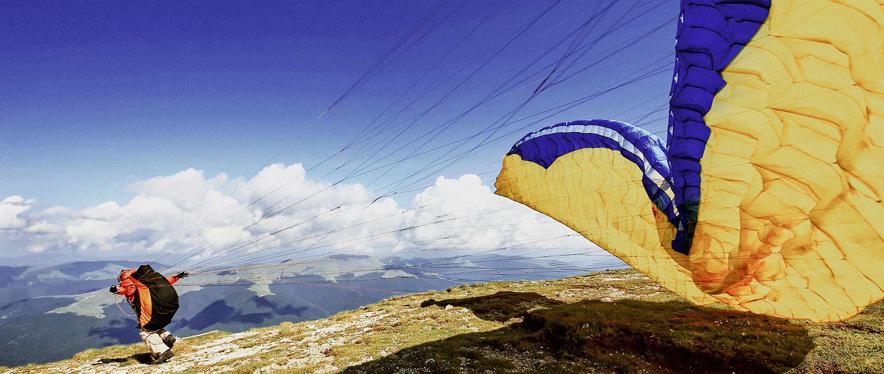
How's your bank
working from home
George Proorocu / Mihai Popa / Mihai Roman
October 2021
Notes:
MP

Slide 2
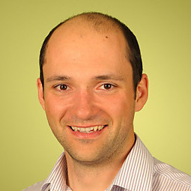
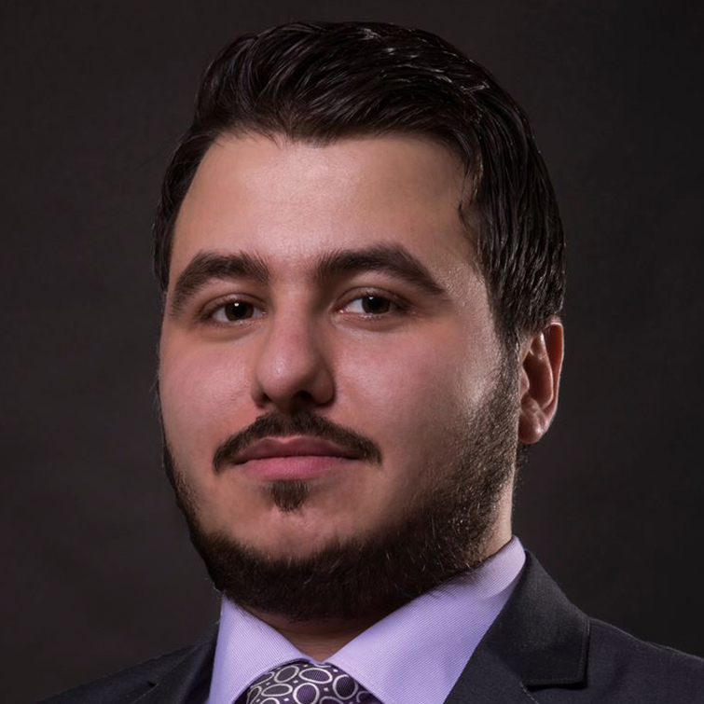
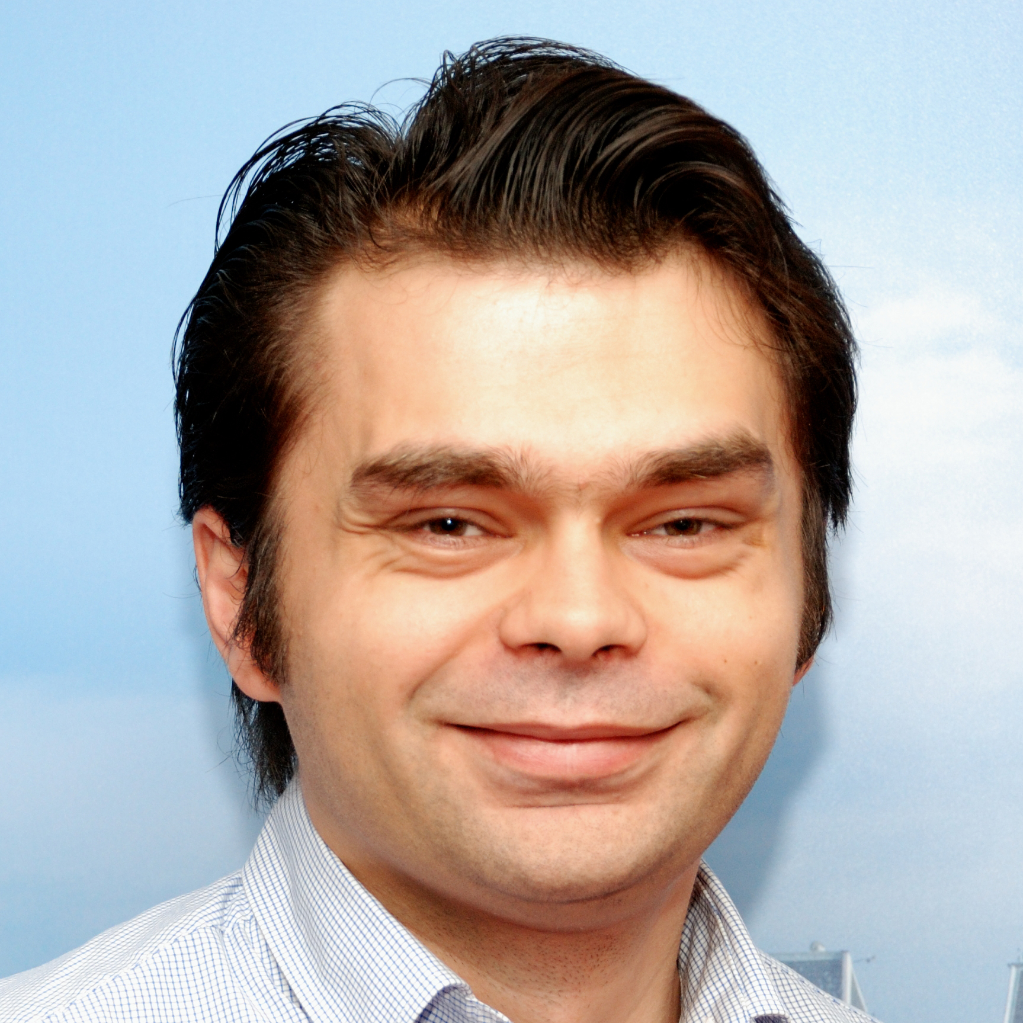
Who are we?
Mihai Popa
Head of Global Consumer Lending Platform
George Proorocu
IT OPS Chapter Lead Cybersecurity and Fraud
Mihai Roman
Engineering Chapter Lead Cybersecurity and Fraud
@MrMihaiPopa
@AurelProorocu
@Mihai_roman
2
Notes:
MP

Slide 3
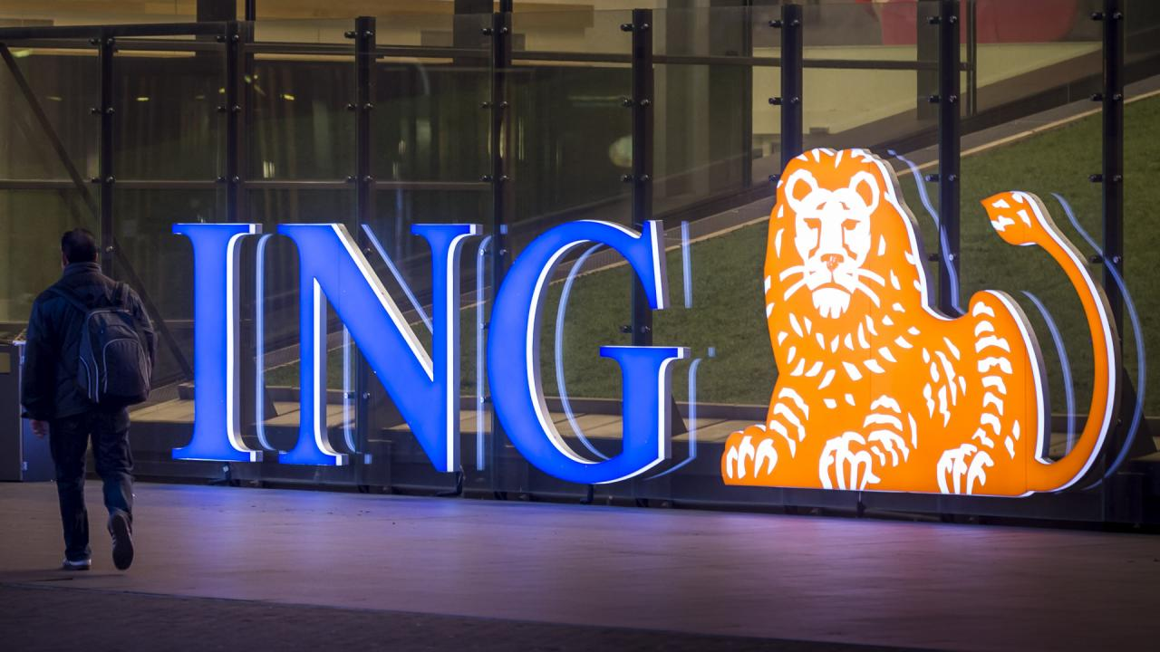
Notes:
GP

Slide 4
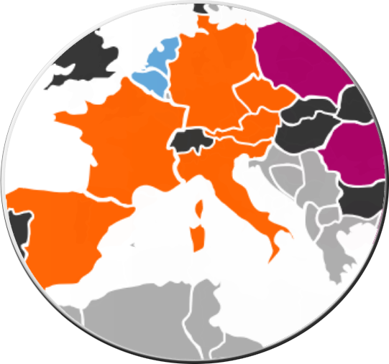
Market leaders: Netherlands, Belgium, Luxembourg
Challengers: Germany, Austria, Czech Republic, Spain, Italy, France, Australia
Growth Markets: Poland, Romania, Turkey, the Philippines and our stakes in Asia
Wholesale Banking Network and global franchises

Slide 5
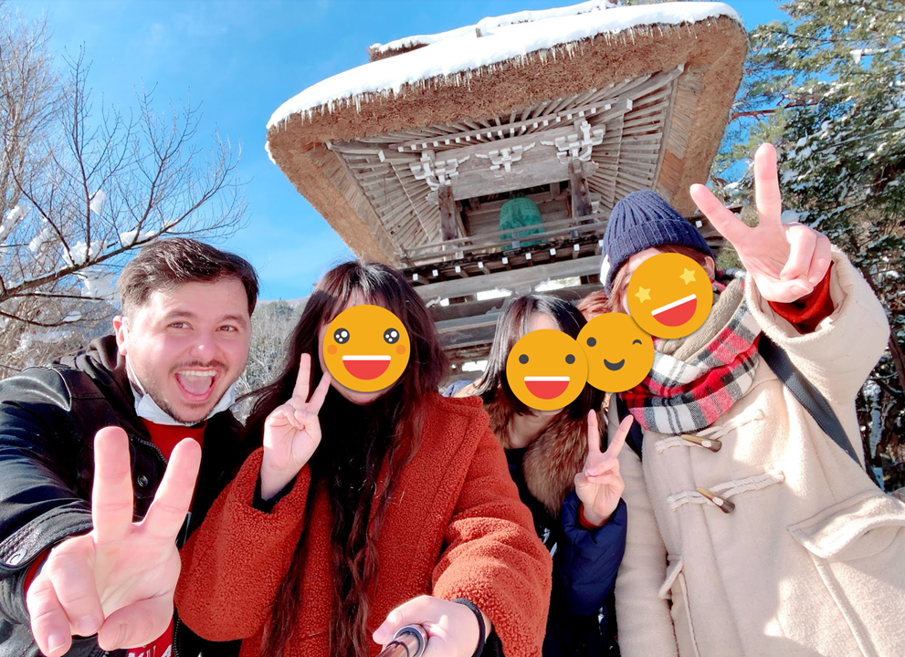
Story of how Corona started
1st February 2020

Slide 6
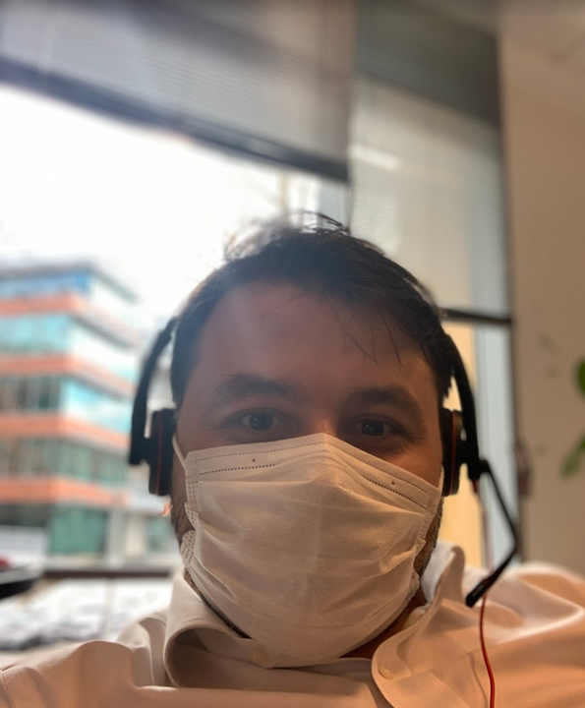
Story of how Corona started
@Office 11th February 2020

Slide 7

First weeks/challenges
Started working remotely
IT challenges
HWoW – home way of working

Slide 8



First 3 months
Accountability
Trust

Slide 9
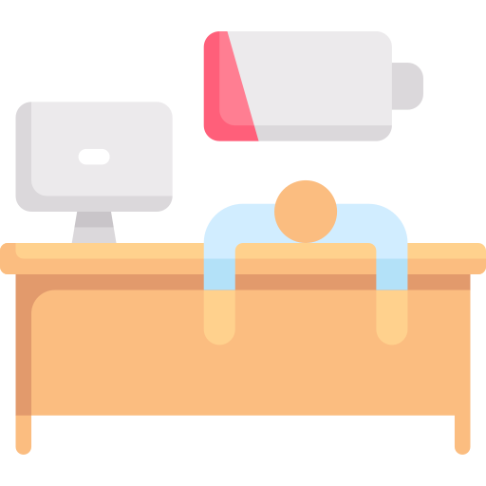

First 3 months
We observed 2 different behaviors:

Slide 10

Leading by example

Slide 11
First 3 months – leading by example
Virtual games
Virtual coffee corners
Regular check-ins
Events

Slide 12

How did ING support us?
ING provided a rotation system:
In case they were feeling lonely at home
In case they couldn’t setup a home-office
Giving the possibility to work from another country
Offered budget/discounts for office & IT equipment

Slide 13

How did ING support us?
In some of the countries it paid for home-staying costs
ING encourages you to work from home up to 60-70%
Dedicated slots in everybody’s agenda for focus (meeting-free blocks)
Pulse check surveys done every month & results/actions discussed with leadership team

Slide 14



What did WE do?
More often interactions with our engineers, not only 1:1s -> connect more on a personal level
Having video calls & paying more attention to micro actions when discussing with people
We’ve kindly asked people to turn on their cameras whenever possible, and use adequate hardware (microphone) to make the transition easy

Slide 15



What did WE do?
We started meeting with the people outside to have 121s while walking when the situation allowed
Created the norm for the engineers to access the majority of the tools without VPN
We trusted our people!

Slide 16

Awareness & Security
Mental health
Dummy MFA approvals
Physical security (devices, etc.)
Notes:
MR

Slide 17



Looking at the future
Hybrid / office / home
Psychological safety
Last but not least, trust the people!
Notes:
MR

Slide 18



Looking at the future - Hybrid / office / home
Let the people decide what’s best for the team
Create the environment to facilitate their conversations
Build ground rules where you facilitate the touchpoints
Be Agile
Notes:
MR

Slide 19

Looking at the future - Psychological safety
Build this, it’s important in cross functional and cross-locations
Asses where you are and measure where you want to go
Encourage good behaviors
Celebrate mistakes but not the repetition

Slide 20

Looking at the future - Psychological safety
Find your own way – old habits will change as the world is changing
Trust the people! Empower them

Slide 21



Conclusion
Exceptional times require exceptional measures
It’s important to support & connect with your colleagues
Create the right environment for the new normal
Stay a step ahead
Stay safe!
Notes:
MR

Slide 22








Thank you!
Q&A
ing.com
@ING_News
LinkedIn.com/company/ING
SlideShare.net/ING
Medium.com/ing-blog
ingwb.com
Facebook.com/ING
YouTube.com/ING
Flickr.com/INGGroup

